Slide 1
RGB LED Matrix Panel
2025-05-21
TA

Slide 2
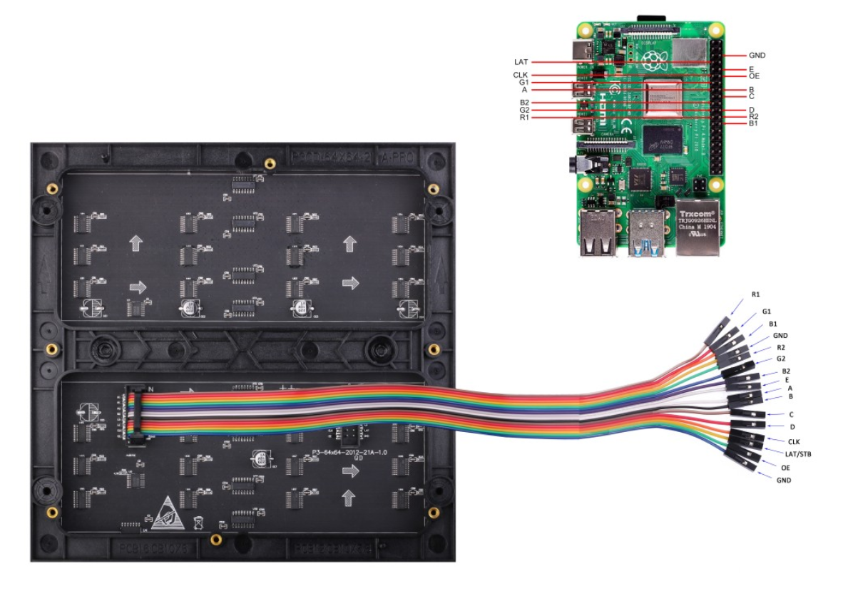
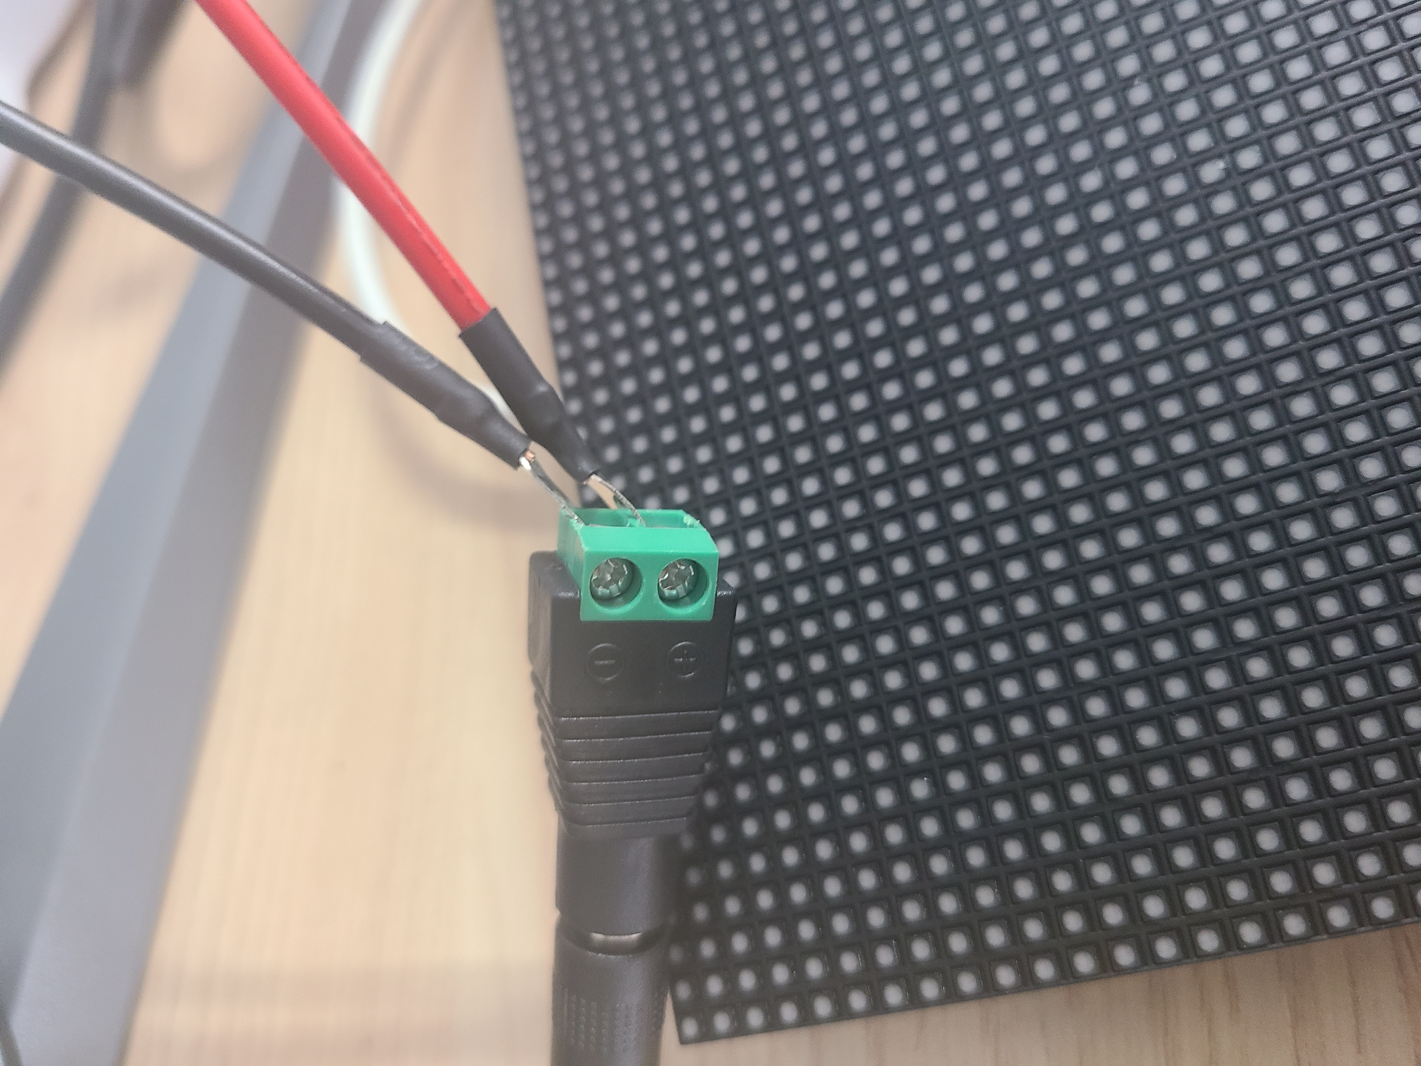
Seengreat wiki
https://seengreat.com/wiki/74/rgb-matrix-p3-0-64x64
GND 선이 2개이므로, 하나만 사용
5V 4A power, +는 빨강, -는 검정선과 연결
Notes:
Retrieval-Augmented Generation for Large Language Models: A Survey

Slide 3
Demo code and open source
https://github.com/seengreat/RGB-Matrix-P3.0-64x64
https://github.com/hzeller/rpi-rgb-led-matrix
Follow the demo to verify that the connection is working correctly
Now implement your LED matrix to display the board state
Notes:
Retrieval-Augmented Generation for Large Language Models: A Survey

